Slide 1
Password Generator
By :- Vansh Gupta
Roll no. :-2022a1r059

Slide 2

Introduction
Briefly explain the significance of strong and secure passwords in today's digital world.
State the need for an automated solution to simplify password creation and enhance data security.
Introduce the Password Generator project and its objective to address these challenges effectively.

Slide 3
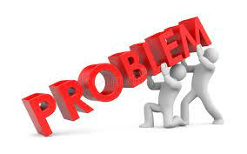
Problem Statement
Manually creating strong and secure passwords is time-consuming and challenging.
Users struggle to generate passwords that are difficult to guess and crack.
Weak passwords pose a significant risk to data privacy and increase the likelihood of unauthorized access.

Slide 4
What is the uniqueness of the bot?
Random and Complex Passwords: Generates highly secure and complex passwords that are extremely difficult to guess or crack.
Integration Capabilities: Seamlessly integrates with other systems or password management tools for enhanced security across platforms.
Compliance with Best Practices: Follows industry standards and guidelines, such as NIST recommendations.
User-Friendly Interface: Easy-to-use interface for generating passwords without technical expertise.

Slide 5
Flowchart
Start
|
V
Generate Random Password
|
V
Check Complexity Requirements
| |
| V
| Display Generated Password
| |
| V
| Store Password (in excel)
| |
| V
| |V
End

Slide 6
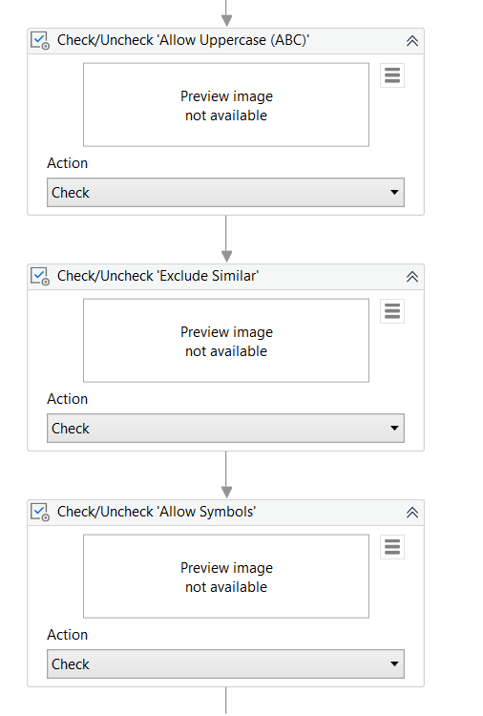
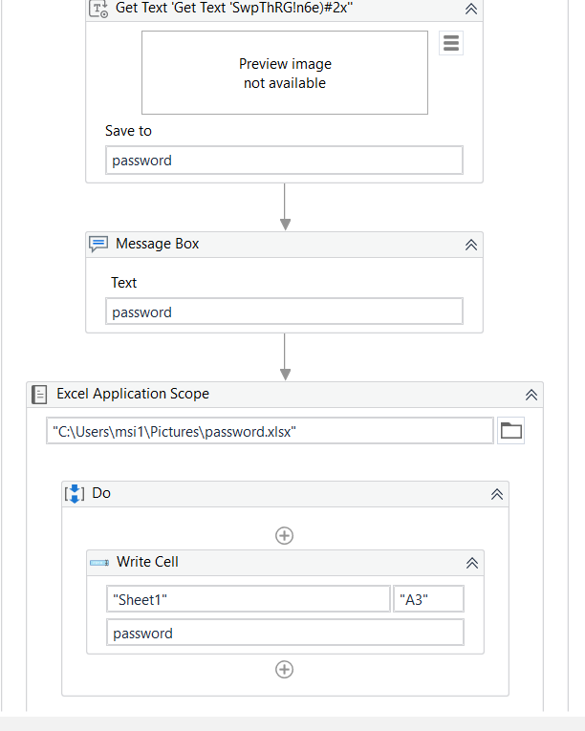
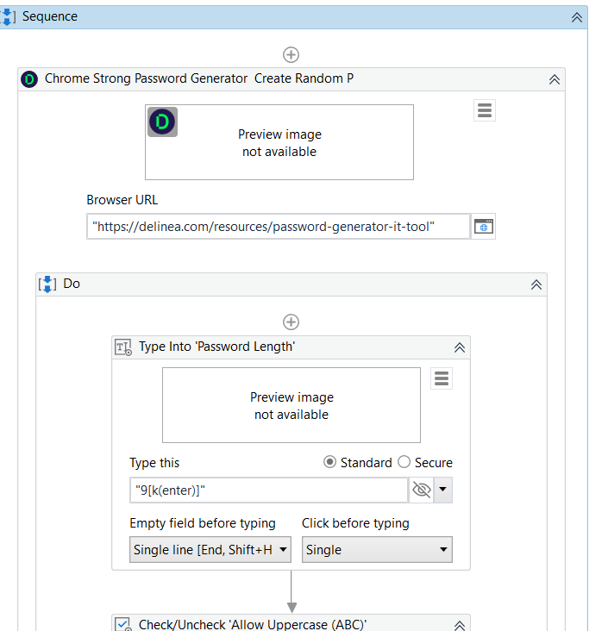
Workflow of the bot

Slide 7
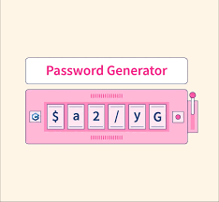
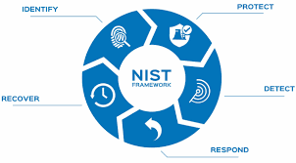


Some popular Ai Tools used in bot

Slide 8
Thank You

